Slide 1
Continual Learning Techniques for Image Classification
Finlay Boyle
Supervised by Dr Donald Sturgeon
Durham University, Department of Computer Science
Notes:
Continual Learning Techniques for Image Classification

Slide 2
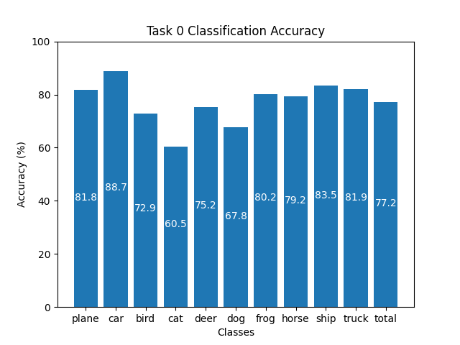
Training Machine Learning Models
Standard training technique: Offline Training
Repeated optimisation over batches
Requires access to entire dataset
High-quality results
Limitations:
Restrictive dataset requirement
Suffers from Catastrophic Forgetting
Figure 1: Offline Training on CIFAR-10 for 100 epochs
Notes:
Outline Offline Training: batches -> optimisation -> backpropagation
[Use Laser Pointer] CIFAR-10, ResNet-18, 100 epochs, 77% accuracy
Limitations: requires whole dataset
Catastrophic Forgetting fe-nom-en-non

Slide 3
Catastrophic Forgetting
Catastrophic Forgetting: The complete and sudden loss of previously acquired knowledge in a neural network [1]
Sequentially updating with new data causes forgetting
Offline Training lacks context of prior knowledge
Ability to learn continually often ignored [2]
Notes:
Repeat definition word-for-word as it is key
Unseen data -> overwriting -> forgets
Lack of context is cause

Slide 4
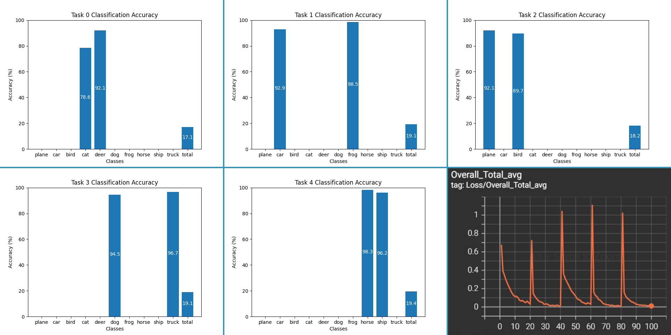
Example of Catastrophic Forgetting
Figure 2: Applying Offline Training sequentially to the same model with separate tasks causes Catastrophic Forgetting. Bottom right: Overall loss. Other images are classification accuracy.
Notes:
CIFAR-10 split 5/2
20 epochs each
[Use Laser Pointer] to illustrate forgetting
Show peaks of loss at new tasks

Slide 5
Continual Learning
Continual Learning: A collection of techniques to overcome Catastrophic Forgetting [3]
Rose to prominence with Elastic Weight Consolidation in 2017 [4] and is actively researched
Primarily focused on alternative methods to Offline Training
Smaller focus on network architecture [5] and dynamic networks
Does not require access to entire dataset
Notes:
Study of techniques to overcome CF
EWC - outline of penalising weight changes
Literature mainly focused on training techniques
Uptick in architecture
Relaxation of the requirements for the whole dataset to be present

Slide 6
Part I: Literature Evaluation
Initial focus on implementing and evaluating existing techniques
Aim: provide a robust comparison between existing methods
Deliverables:
Implementation of Baselines: Finetuning and Offline Training
Historical Techniques such as Elastic Weight Consolidation [4]
State of the Art: GDumb [6], Rainbow [7], Mnemonics [8]
Cutting Edge: Learning to Prompt [9] and meta-learning techniques [10]
Evaluation and comparison of techniques
Notes:
Initial focus
Implementing and comparing literature techniques
GDumb authors highlighted issues
Difficult to compare SoTA
Baselines: Offline Training and Finetuning (FT like CF example)
Historical: Elastic Weight Consolidation – discussed earlier
SoTA:
GDumb – subset inference time training
Rainbow – representative of class, discriminative of others
Mnemonics – stores samples, optimises them during training
Cutting Edge:
Learning to Prompt – learns small prompts/inputs to attach to real input for inference
Meta-learning – learning to learn to preserve knowledge
Conduct fair experimentations
Metrics:
Overall accuracy, training time, memory consumption
CL specific: average forgetting – decrease in performance between tasks

Slide 7
Part II: Novel Experimentation
Focus will shift to gaps in the literature
Aim: experiment with potential future research areas
Will be influenced by the cutting-edge techniques
Experimenting with architecture [5] and sampling methods
Deliverables:
Establishing a theoretical underpinning to ensure there exists potential
Implementation of experiments and different approaches
Evaluation and comparison with techniques from Part I
Notes:
Focus next on literature gaps
Aim to contribute
Cutting-edge techniques influence
Deliverables:
Theoretical underpinning
Implementation
Comparison with Part I
Possible avenues:
Improvements to sampling techniques,
Experimenting with feature extraction,
Investigating dynamic network structures

Slide 8
Applications of Continual Learning
Continual Learning offers real-world benefits
Training models can be expensive [11]
Continual Learning could save computational resources and time [12]
Real-time applications can adapt to changing data distributions
Mainly focused on Image Classification
Can be applied to other domains such as Natural Language Processing [13]
Notes:
Offers real-world benefits
Retraining is expensive
Energy usage
Computation resources
Time
CL could significantly reduce cost of updating models
Real-time applications could benefit
Update on-the-fly in real time -> give businesses edge with cost reductions
Image classification is main domain
Has also been applied to Natural Language Processing

Slide 9
References
[1] McCloskey, Michael, and Neal J. Cohen. "Catastrophic interference in connectionist networks: The sequential learning problem." Psychology of learning and motivation. Vol. 24. Academic Press, 1989. 109-165.
[2] Hecht-Nielsen, Robert. "Neurocomputing: picking the human brain." IEEE spectrum 25.3 (1988): 36-41.
[3] Parisi, German I., et al. "Continual lifelong learning with neural networks: A review." Neural Networks 113 (2019): 54-71.
[4] Kirkpatrick, James, et al. "Overcoming catastrophic forgetting in neural networks." Proceedings of the national academy of sciences 114.13 (2017): 3521-3526.
[5] Mirzadeh, Seyed Iman, et al. "Architecture matters in continual learning." arXiv preprint arXiv:2202.00275 (2022).
[6] Prabhu, Ameya, Philip HS Torr, and Puneet K. Dokania. "Gdumb: A simple approach that questions our progress in continual learning." European conference on computer vision. Springer, Cham, 2020.
[7] Bang, Jihwan, et al. "Rainbow memory: Continual learning with a memory of diverse samples." Proceedings of the IEEE/CVF Conference on Computer Vision and Pattern Recognition. 2021.
[8] Liu, Yaoyao, et al. "Mnemonics training: Multi-class incremental learning without forgetting." Proceedings of the IEEE/CVF conference on Computer Vision and Pattern Recognition. 2020.
[9] Wang, Zifeng, et al. "Learning to prompt for continual learning." Proceedings of the IEEE/CVF Conference on Computer Vision and Pattern Recognition. 2022.
[10] Hadsell, Raia, et al. "Embracing change: Continual learning in deep neural networks." Trends in cognitive sciences 24.12 (2020): 1028-1040.
[11] Wiggers, Kyle. "AI Weekly: AI Model Training Costs on the Rise, Highlighting Need for New Solutions." VentureBeat, 15 Oct. 2021, https://venturebeat.com/ai/ai-weekly-ai-model-training-costs-on-the-rise-highlighting-need-for-new-solutions/.
[12] Mai, Zheda, et al. "Online continual learning in image classification: An empirical survey." Neurocomputing 469 (2022): 28-51.
[13] Biesialska, Magdalena, Katarzyna Biesialska, and Marta R. Costa-Jussa. "Continual lifelong learning in natural language processing: A survey." arXiv preprint arXiv:2012.09823 (2020).
Notes:
Thank you for listening, here are the references for the presentation.

